Slide 1

Domain: MATLAB
Technology: COMMUNICATION
LEACH PROTOCOL ENHANCEMENT FOR INCREASING WSN LIFETIME

Slide 2
Index
Abstract
Introduction
Literature review
Existing Method
Disadvantages
Proposed method
Advantages
Applications
Hardware and Software Requirements
Results
Conclusion
Future scope
References

Slide 3
Abstract
WSNs have been one of the most widely used methods in a variety of uses, including agriculture, factory inspection, health care, and fire detection. WSN is a television network that broadcasts in has many benefits, including low cost, compact scale, and ease of use. multifunctional, self-organizing, and capable of WSN routing standard operating procedures WSN, on the other hand, has several drawbacks, obstructs certain uses, such as those with a reduced battery life or a short lifespan. Sensor deployment area and sensor energy consumption .In this case, we suggest a new strategy for achieving improved results. In terms of network lifetime and data, WSN can be improved.

Slide 4
Introduction:
Wireless Sensor Network (WSN) consists of a large number of very small sensors deployed in a specific area depending on the desired application . Each sensor contains sensing, data processing, and communication components. These sensors form WSN nodes that transfer the sensing data to the Base Station (BS) or sink. In the BS, the data is processed and computed to give understandable results. The communication between BS and wireless nodes is arranged by different protocols. One of the energy-efficient protocols is the LEACH routing protocol. In this protocol, the network is divided into different clusters and each cluster has elected Cluster Head(CH) which connected with cluster member nodes and the BS, collecting data from the nodes and then sending the aggregated data to the BS .As a cluster head has more functions than the other nodes, so it consumes its energy faster than the other nodes which leads it to die earlier .In this paper, we propose a new algorithm called Secondary Cluster Head (SCH) which becomes a cluster head simultaneously with the death of the previous CH. So, all WSN cluster keep transmitting data even if some nodes dead which increase the network lifetime and performance. LEACH protocol uses TDMA or CDMA routing protocols

Slide 5
Literature review:
S. NO | Journal Type with year | Authors | Title | Outcomes
1 | IEEE Communications magazine 40.8 (2002): 102-114. | Akyildiz, Ian F., et al. | "A survey on sensor networks." | Studied about assimilation of WSN and cloud
2 | Proceedings of the 8th International Conference on Body Area Networks, 2013, pp. 148–152, | M. Quwaider and S. Biswas,, | “Modeling energy harvesting sensors using accelerometer in body sensor networks,” | Studied about A piezoelectric generator model
3 | Proceedings of the 33rd annual Hawaii international conference on system sciences. IEEE, 2000. | Heinzelman, Wendi Rabiner, Anantha Chandrakasan, and Hari Balakrishnan. | "Energy-efficient communication protocol for wireless microsensor networks." | Studied about LEACH outperforms static clustering algorithms
4 | Ad Hoc Netw., vol. 8, no. 8, pp. 824–841, 2010 | M. Quwaider and S. Biswas | “DTN routing in body sensor networks with dynamic postural partitioning,” | Studied about Store-and-forward packet routing protocols
5 | 2004 IEEE international conference on communications (IEEE Cat. No. 04CH37577). Vol. 6. IEEE, 2004. | Mhatre, Vivek, and Catherine Rosenberg. | "Homogeneous vs heterogeneous clustered sensor networks: a comparative study." | Studied about a cost based comparative analysis of single hop homogeneous

Slide 6
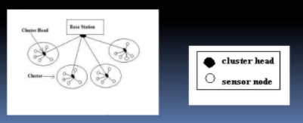
Existing method:
The first proposed clustering protocol is the LEACH(LOW ENERGY ADAPTIVE CLUSTERING HIERARCHY) protocol . The operation of LEACH protocol consists of several rounds with two phases in each :Set-up Phase and Steady Phase.
The Set-Up Phase where Cluster Heads are chosen and Cluster Formation are done. In steady state Phase the data transmission takes place between nodes to CH and CH to BS.The main idea is to choose the CH in a clustered manner at each round and then have the nodes join the closest CH to form a dynamic cluster. This network topology is built on the chosen CHs, which is inefficient due to the lack of consideration for node residual energy. Furthermore, prioritising CH selection results in the forming of complex clusters at each round, resulting in an increase in energy overhead due to cluster formation after each re-selection phase for CHs .

Slide 7
Disadvantages in Existing methods:
1. One of the biggest disadvantage of LEACH is that when due to any reason Cluster head dies, the cluster will become useless because the data gathered by the cluster nodes would never reach its destination i.e. Base Station.
2. CH selection is the most difficult part of dynamic clustering.
3. LEACH disregards the BS and cluster head geographical positions, energy consumption.
4. We have noticed that the cluster head missions are more than the ordinary nodes, so the cluster head consumes more energy than the others which one of the drawbacks of the LEACH algorithm.

Slide 8
Proposed method:
A new algorithm named S-LEACH is used to extend the existence of the system. Cluster Head (CH) and Secondary Cluster (SC) are two options for creating a network. Secondary Cluster Head (SCH) during each round's sensor configuration process. According to previous studies, the shorter the gap, the better. Among CH and BS, the BS has a longer lifespan and is more energy consuming. It's the network. We chose to pick the basis equation. The closest node to the BS is designated as CH, and the closest node to the CH is designated as SCH, taking into account the energy and distance parameters of nodes. Depending on this suggestion, if the CH dead the cluster will not cut off the communication with the sink and the secondary cluster head replace the dead cluster head and pronounces itself as a cluster head. Rather than that, the cluster continuously connecting the sink as long as the active node alive in the cluster.

Slide 9
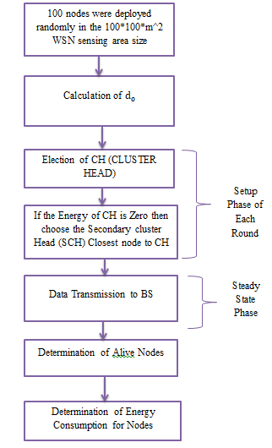
Proposed method:
FIGURE:Block diagram of proposed method

Slide 10
Advantages of Proposed method:
1.If the CH is dead ,the secondary cluster head replace the dead cluster head and pronounces itself as a cluster head.
2.The nearest the distance between CH and BS, the better lifetime and energy-efficient the network is. CH is selected which is nearst to BS.
3.In S-LEACH, the lifetime of the network is improved by selecting Cluster Head (CH) and Secondary Cluster Head (SCH) in the sensor setup phase of each round.
4. Secondary Cluster Head (SCH) is selected nearer to Cluster Head so there is no more energy consumption problem.
5. Some nodes are not able to join the cluster because they have not the range ratio of any cluster, So they connect to BS directly without electing CH by the protocol which called Direct transmission (DTx).

Slide 11
Applications:
1.Industrial control
2.Environmental monitoring,
3. Military surveillance,
4.Intelligent transportation systems and medical field.
5.Furthermore, it can function independently in harsh or high-risk places where human presence is not possible
6.Disaster relief operations.
7.Biodiversity mapping
8.monitoring of temperature, pressure, and humidity

Slide 12
Hardware and Software Requirements:
Hardware & Software Requirements:
Software: Matlab R2018a.
Hardware:
Operating Systems:
• Windows 10
• Windows 7 Service Pack 1
• Windows Server 2019
• Windows Server 2016
Processors:
Minimum: Any Intel or AMD x86-64 processor
Recommended: Any Intel or AMD x86-64 processor with four logical cores and AVX2 instruction set support
Disk:
Minimum: 2.9 GB of HDD space for MATLAB only, 5-8 GB for a typical installation
Recommended: An SSD is recommended a full installation of all Math Works products may take up to 29 GB of disk space
RAM:
Minimum: 4 GB
Recommended: 8 GB

Slide 13
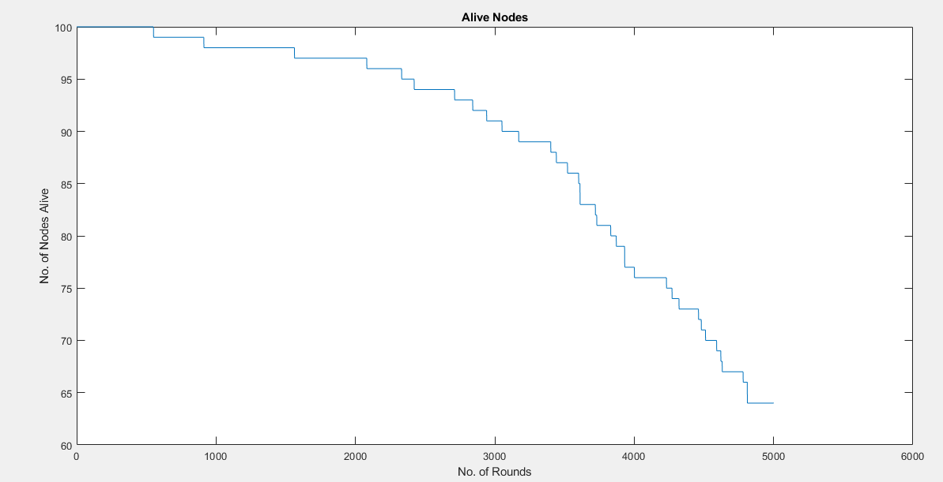
Results and Discussions:
Figure : Number of live nodes

Slide 14
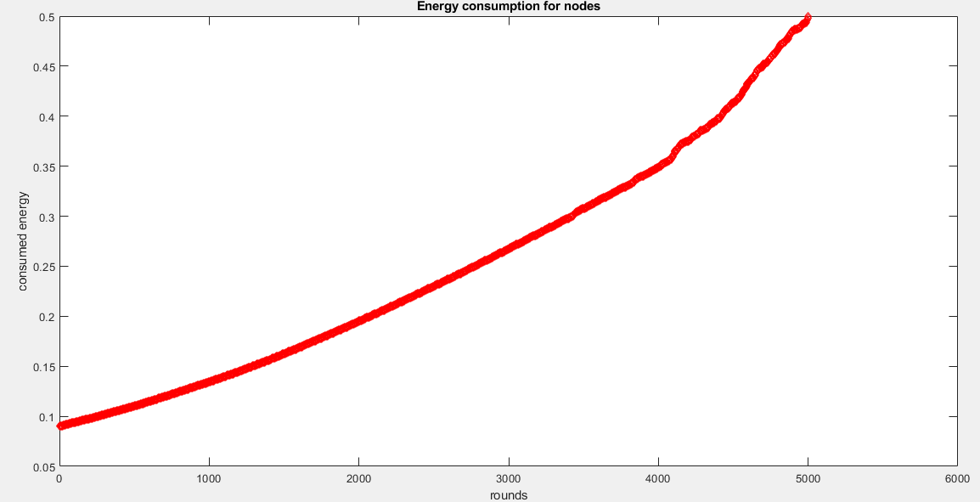
Results and Discussions:
Figure : Energy consumption for effective network

Slide 15
CONCLUSION:
The wireless sensor networks are widely used in different areas. LEACH protocol is one of the most popular approaches in WSN. In this paper, we proposed a new algorithm called Secondary Cluster Head (SCH), which becomes a cluster head simultaneously with the death of the previous CH. Therefore, all WSN cluster keep transmitting data even if some nodes dead, which increase the network lifetime and the network performance. Also, that increased the number of transmitted data packet in the network with the same network settings compared with the basic LEACH protocol.

Slide 16
Future Scope
As future work, it would be worth to apply the proposed S-LEACH algorithm in different WSN routing protocols to minimize network traffic and the best path for data to travel from cluster to sink.

Slide 17
References:
[1] Akyildiz, Ian F., et al. "A survey on sensor networks." IEEE Communications magazine 40.8 (2002): 102-114.
[2] M. Quwaider and S. Biswas, “Modeling energy harvesting sensors using accelerometer in body sensor networks,” in Proceedings of the 8th International Conference on Body Area Networks, 2013, pp. 148–152, Accessed: Nov. 27, 2014. [Online]. Available: http://dl.acm.org/citation.cfm?id=2555348.
[3] Heinzelman, Wendi Rabiner, Anantha Chandrakasan, and Hari Balakrishnan. "Energy-efficient communication protocol for wireless
microsensor networks." Proceedings of the 33rd annual Hawaii international conference on system sciences. IEEE, 2000.
[4] M. Quwaider and S. Biswas, “DTN routing in body sensor networks with dynamic postural partitioning,” Ad Hoc Netw., vol. 8, no. 8, pp. 824–841, 2010.
[5] Mhatre, Vivek, and Catherine Rosenberg. "Homogeneous vs heterogeneous clustered sensor networks: a comparative study." 2004 ,IEEE international conference on communications (IEEE Cat. No. 04CH37577). Vol. 6. IEEE, 2004.

